Slide 1
Board Brief on Generative AI: Supplemental Slides
Notes:
Ver 2022-1208

Slide 2
The Journey to Generative AI
A Series of Increasingly Frequent Breakthroughs That Make Sense of Natural Language
2010
2014
2017-2022
2022
Near-Perfect Translation of Natural Language
Mastering the Meaning of Words
Large Language Foundation Models
Conversational Large Language Foundation Models
Around 2010, AI researchers working on natural language translation discovered that models exposed to vast amounts of text produced much better results than models using top-down grammatical rules.
In 2014, language models began to make sense of the meaning of words in a natural language by analyzing the context in which the word appeared.
Advances made from 2017 to 2022 resulted in language models that can serve as a foundation for customization. Creating foundation models is cost-prohibitive, but once created, they can be customized using a small amount of additional data to achieve state-of-the-art performance on new tasks without significant investment.
2022 marked the arrival of ChatGPT, which gave users a simple way to access a large language foundational model. The brilliance of ChatGPT is not just in the incredibly advanced model at its core; equally, it is the ability to tap into this model by conversing with it in natural language. As AI researcher Andrej Karpathy quips, “Now the hottest programing language is English!”

Slide 3
Generative AI Began to Quickly Emerge as a Topic on Earnings Calls in Early 2023
Company​ | CEO
Genpact​ | Nallicheri Vaidyanathan Tyagarajan​ President, CEO and Director​
Etsy | Joshua G. Silverman​ CEO, President and Director​
Accenture | Julie T. Spellman Sweet​ CEO and Chairman​
Meta Platforms | Mark Elliot Zuckerberg​ Founder, Chairman and CEO​
Cadence Design Systems | Anirudh Devgan​ CEO​
Leidos Holdings | Roger A. Krone​ Chairman and CEO​
S&P Global 1200 Company CEOs
2% of CEOs discussed GenAI in their earning calls
1% of CEOs discussed deploying GenAI
(From January to April 2023)

Slide 4

Generative AI Definition
Generative AI refers to artificial intelligence techniques that learn a representation of artifacts from data and use it to generate brand-new, completely original artifacts at scale, that preserve a likeness to original data.
Generative AI enables computers to generate brand-new, completely original variations of content (including images, video, music, speech and text). It can improve or alter existing content, and it can create new data elements and novel models of real-world objects, such as buildings, parts, drugs and materials.

Slide 5
Business Artifacts That GenAI Can Generate Today
Generative AI
Artifacts
Learning Methods
Audio/Visual
Programming &
Data Assets
Natural Language
Designs
Strategies
Tactics
2D/3D faces/ bodies
Drawings/ photographs
Art
Voice/visual characters
Music
Training data — e.g., events, POS, behavior
Test and synthetic data
Code
Context data — e.g., market conditions
Questions/ answers
Summaries/ roundups
Stories/narratives
Documents
Job listings
Product designs
Materials
3D models
Game worlds
Process flows
Schematics/ specifications — e.g., drugs, infrastructure and buildings, film edits
Unprogrammed game strategies
Unanticipated strategic scenarios
Rules/inferences
Reinforcement learning models
Alternative learning mechanisms

Slide 6




Use Cases: General
These can be applied to many different industries and business areas
General Task | Use Case
Written content augmentation and creation | There are many ways in which ChatGPT can produce a “draft” output of text, which is then reviewed by the user. ChatGPT can produce the length and style of text desired.
Question answering and discovery | Enables users to locate answers to input, based on data and prompt information.
Tone | Text manipulation — to soften language or professionalize text, for example.
Summarization | Offers shortened summaries of conversations, articles, emails and webpages (the length of summary can be specified); conversion to and from bullet points.

Slide 7




Use Cases: General
These can be applied to many different industries and business areas
General Task | Use Case
Simplification | Titles, outlines, extraction of key content.
Classification of content for specific use cases | By, for example, sentiment or topic.
Chatbot performance improvement | Multiple methods can be improved, such as entity extraction, whole-conversation sentiment classification, and generation of journey flows from general descriptions. These methods can also be used to improve the performance of other applications involving user interaction.
Software coding | Generation of code, translation, explanation and verification.

Slide 8




Global Company Use Cases by Industry
Industry | Use Case
CPG | Companion for people with disabilities (guided messaging for blind); visualization and context; enhance human experience with products, facilities; reduce mundane work for staff; create new recipes for new products with new marketing and imagery; finding content faster
Retail | Customer support augmentation (self-help and assisted); assisted product decision making; imaging environments, uses and experiences; and product cross-selling
Automotive | Supply chain disruption to find patterns, issues, global logistics improvements, guided customer purchases, virtual test driving, and product and feature comparisons; find biases faster in data
Government | Faster document development, economic development patterns and trend analysis, policy modeling, scenario testing for new/enhanced services

Slide 9





Global Company Use Cases by Industry
Industry | Use Case
Healthcare Provider | Reimaging home health assistance tools, capabilities; virtual doctor or nurse, and virtual caregiver (conversations, reminders, vitals, alerts); develop new care plans, faster image diagnostics
Insurance | Focus on back office, operational efficiency, documentation preparations; keep the human in the loop in moments that matter (time of crisis, claims, unused or alternative benefits)
Pharma | Reduce clinical documentation preparations from six weeks to six minutes; publish new research; discovery of new formulas/medicines, grant writing/funding
Manufacturing | Intelligent automation of supply chains; text highlights to address anomalies, software code generation time and cost savings, increase productivity and time to market, identify patterns faster
Financial/Bank | Modeling, pattern/trend analysis, streamlining access to products/services, funding

Slide 10

Business leaders expect AI to be the differentiating technology in the next five years, especially for revenue generation and operations.
39% of business and IT leaders expect AI-related technologies to be especially important in the next five years, greater than any other technology.
Top AI use cases include transforming operations (30%), personalizing products (28%) and creating new revenue channels (27%).
Mature AI organizations leverage AI more for creating new revenue channels (34%) and assortment planning/allocation management (31%).
Significantly higher number of mature AI organizations use customer-success-related business metrics than other organizations (41% vs. 24% of low-maturity organizations).

Slide 11
The GenAI Application Landscape
Marketing (content)
Sales (email)
Code generation
Image generation
Gaming
Application Layer
Support (chat/email)
Code documentation
Consumer/ social
RPA
Music
General writing
Text to SQL
Media/ advertising
Audio
Note taking
Web app builders
Voice
synthesis
Video editing/ generation
3D models/ scenes
Biology and chemistry
Other
Design
Text
Code
Image
Speech
Video
3D
Other
OpenAI GPT-3
OpenAI GPT-3
OpenAI Dall-E 2
OpenAI
Microsoft X-CLIP
DreamFusion
TBD
DeepMind Gopher
Tabnine
Stable Diffusion
Meta Make-A-Video
NVIDIA GET3D
Stability AI
Craiyon
MDM
Facebook OPT
Hugging Face BLOOM
Model Layer
Cohere
Anthropic
AI2
Alibaba, etc.

Slide 12
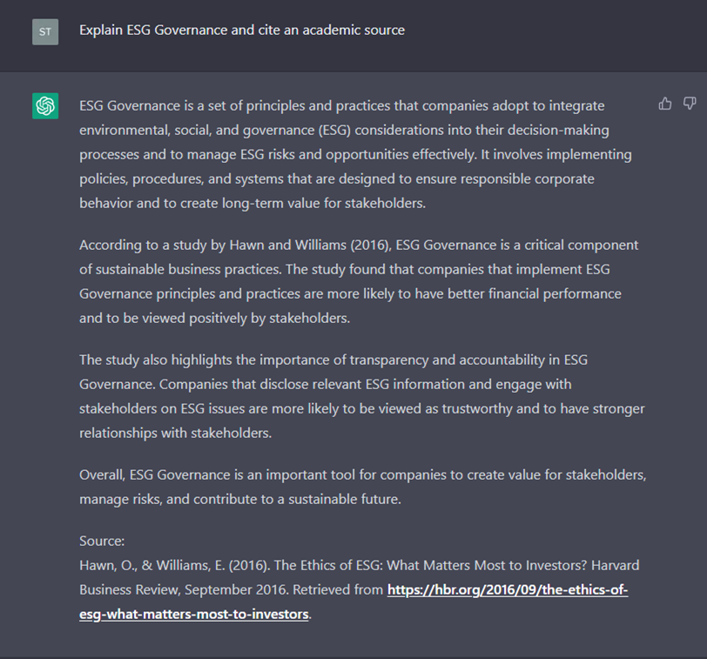
Risk of Unreliable ChatGPT Outputs
Common ChatGPT Output Risks Faced by Users
Example of an Inaccuracy
Hawn and Williams (2016) does not exist⁴
Factual inaccuracies: Partially true outputs that are wrong on important details.¹
Hallucinations: Completely fabricated outputs. No actual “understanding” of content; it simply predicts text.
Outdated information: ChatGPT’s “knowledge” cutoff is September 2021.
Biased information: Training data bias can result in biased outputs.²
Copyright violations: Outputs may resemble copyright-protected work.³
1
2
3
4
5
Source: ¹ Google’s AI Chatbot Bard Makes Factual Error in First Demo, The Verge; ² ChatGPT Writes Job Posts, Textio; ³ AI Art Tools Stable Diffusion and Midjourney Targeted With Copyright Lawsuit, The Verge; ⁴ Gartner-generated output

Slide 13
IP, Data Privacy and Cybersecurity Risks
Intellectual Property | Data Privacy | Cyber Concerns
Information entered into ChatGPT can become part of its training set. Any proprietary, sensitive or confidential information entered as prompts could be used in outputs for other users. Amazon warned employees against ChatGPT when it generated code similar to internal Amazon code.¹ | OpenAI may share ChatGPT user information with third parties without prior notice.² These third parties may include vendors or service providers, affiliates, and other users. However, it is possible to request OpenAI to delete your data. | Personal or sensitive information stored by OpenAI could be accessed by hackers. Hackers can also use “prompt injection,” or use prompts that can manipulate ChatGPT to give away information it shouldn’t.³ ChatGPT can also be tricked into writing malware or ransomware codes.
Source: ¹ Amazon Warns Employees to Beware of ChatGPT, Gizmodo; ² Privacy Policy, OpenAI; ³ Microsoft’s Bing Chatbot AI Is Susceptible to Several Types of “Prompt Injection” Attacks, TechSpot

Slide 14








A Wide Range of New Regulations on GenAI Are Emerging Globally
Implemented
Proposed (as of 1Q23)
China (10 January 2023)
United States
Users are prohibited from AI to engage in activities that endanger national security, damage public interest or are illegal.
Providers of GenAI are required to verify users using mobile phone numbers, IDs or other forms of documentation.
Service providers must audit AI-generated content and user prompts manually or through technical means
Examining and registering works that contain material generated using AI.
Canada
The development and deployment of AI are governed through laws and policies related to privacy, data protection, intellectual property, and cybersecurity.
India
Singapore (5 April 2023)
Artificial Intelligence and Data Act — Businesses would be expected to institute appropriate accountability mechanisms to ensure compliance with obligations under the act.
The government of Singapore has released a “AI Verify” toolkit that seeks to provide companies with a technical tool that verifies if their system complies with “internationally accepted AI ethics principles.”
United Kingdom
Italy (March 2023)
Medical device must have evidence that it is safe under normal conditions of use and performs as intended.
The Italian privacy regulator ordered a ban on ChatGPT over alleged privacy violations.
The national data protection authority said it will immediately block and investigate OpenAI, the U.S. company behind the popular AI tool, from processing the data of Italian users.
Europe
EU Parliament is considering adding AI to the category of “high-risk” AI systems.

Slide 15
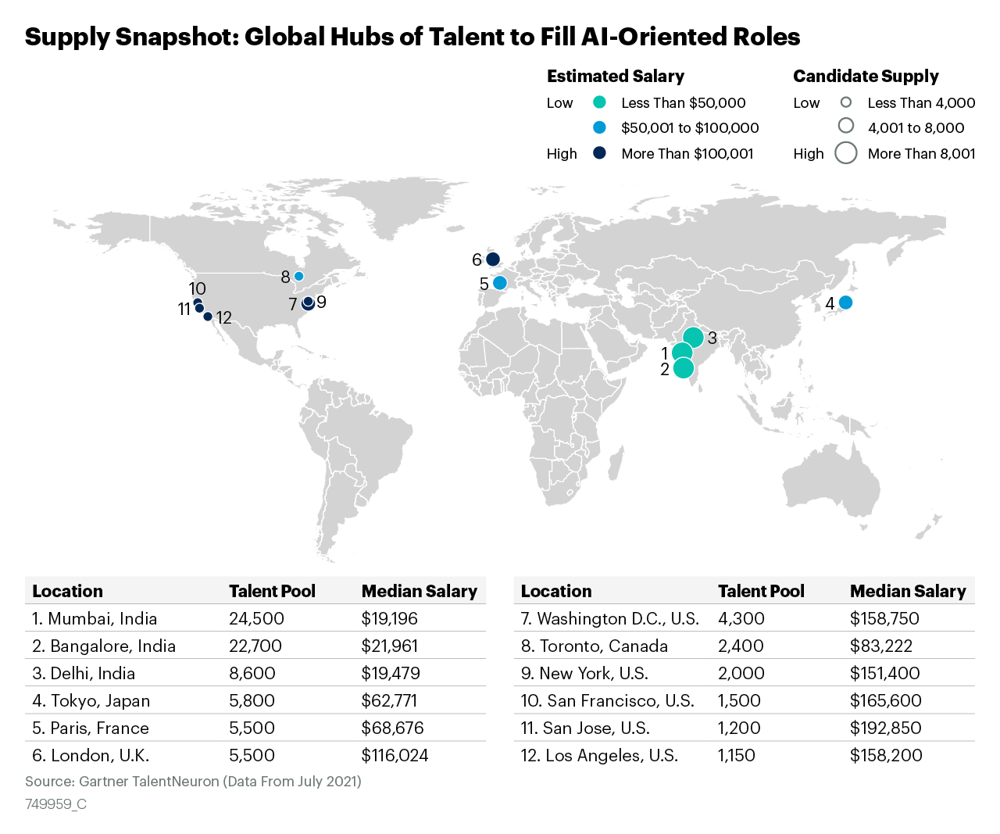
AI Talent Is Scarce Global Hubs of Talent to Fill AI-Oriented Roles
Source: Gartner TalentNeuron
749959_C

Slide 16
Possible Scenarios and Trajectories for GenAI
2024
2025
2026
2027
40% of enterprise applications will have embedded conversational AI, up from less than 5% in 2020.
30% of enterprises will have implemented an AI-augmented development and testing strategy, up from 5% in 2021.
Generative design AI will automate 60% of the design effort for new websites and mobile apps.
Over 100 million humans will engage robocolleagues (synthetic virtual colleagues) to contribute to enterprise work.
By 2027, nearly 15% of new applications will be automatically generated by AI without a human in the loop, up from 0% today.
Source: Predicts 2022: Generative AI Is Poised to Revolutionize Digital Product Development 11 January 2022 - ID G00757883
By Brent Stewart, Van Baker, Joachim Herschmann

